Slide 1
MEDICAL MANAGEMENT OF SEVERE ASTHMA
Dinesh Pillai, MD
Director, Severe Asthma Program
Division of Pulmonary and Sleep Medicine
Children's National Hospital
Associate Professor of Pediatrics and Genomics & Precision Medicine
The George Washington University School of Medicine and Health Sciences

Slide 2
Learning Points
Managing step up therapy in general pediatrics
Clinical considerations for general practitioners in uncontrolled asthma
Current evaluation and therapeutic options for children with severe persistent asthma

Slide 3
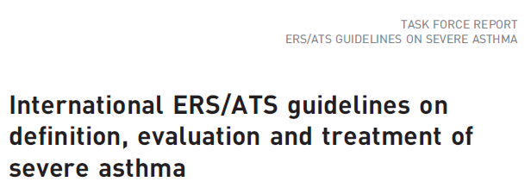
Current Severe Asthma Guidelines

Slide 4
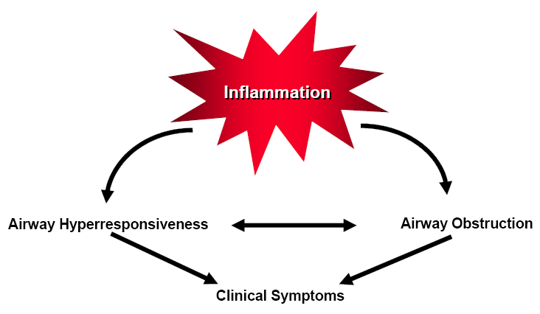
Asthma: Basic Definition
Cough, wheeze, shortness of breath
Response to bronchodilator
National Heart, Lung, and Blood Institute. Expert panel report 3:
guidelines for the diagnosis and management of asthma—full report 2007. www.nhlbi.nih.gov/guidelines/asthma/asthgdln.pdf.

Slide 5
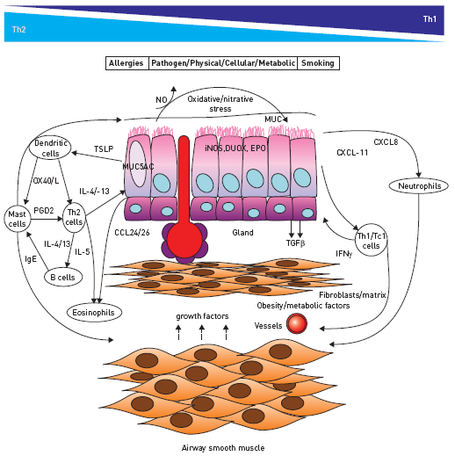
Pathophysiology of Asthma
T2
Immune
Response
T1
Immune response

Slide 6
Current NAEPP Guidelines Classifying Asthma & Initiating Treatment
National Heart, Lung, and Blood Institute. Expert panel report 3:
guidelines for the diagnosis and management of asthma—full report 2007. www.nhlbi.nih.gov/guidelines/asthma/asthgdln.pdf.

Slide 7
Age 0-4 Years
MILD
MODERATE
SEVERE PERSISTENT
National Heart, Lung, and Blood Institute. Expert panel report 3: guidelines for the diagnosis and management of asthma—full report 2007. www.nhlbi.nih.gov/guidelines/asthma/asthgdln.pdf.

Slide 8
Age 5-11 Years
MILD
MODERATE
SEVERE PERSISTENT
National Heart, Lung, and Blood Institute. Expert panel report 3: guidelines for the diagnosis and management of asthma—full report 2007. www.nhlbi.nih.gov/guidelines/asthma/asthgdln.pdf.

Slide 9
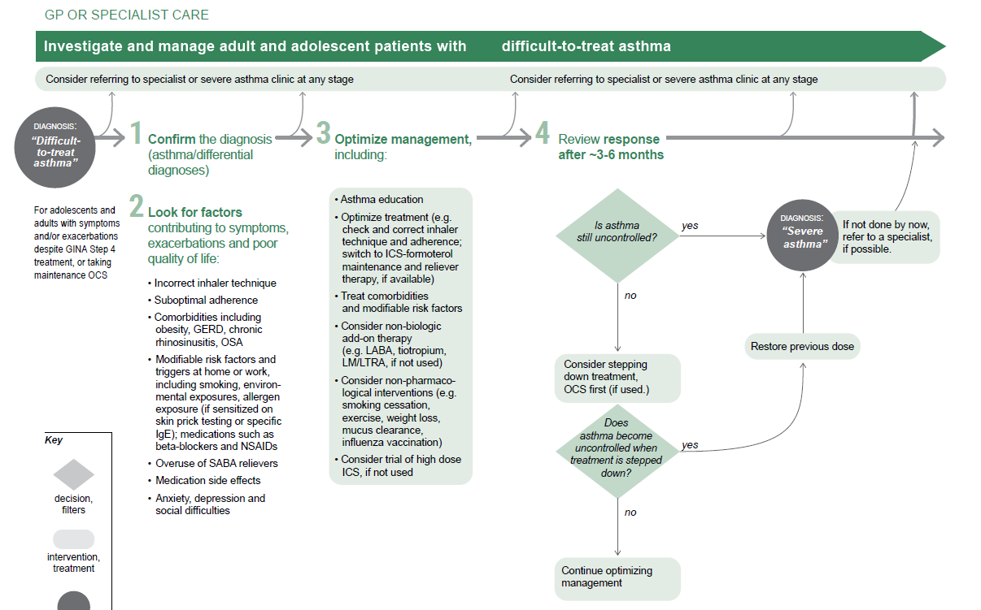
Asthma
Specialist
© Global Initiative for Asthma, www.ginasthma.org

Slide 10
Addressing/Monitoring Asthma Symptoms
ASTHMA SYMPTOMS
Not well controlled
IMPROVED
1. Continue therapy for 3 months
2. Consider step down
FOLLOW UP (GP)
Very concerned: 2-6 wks
Not too concerned: 8-12 wks
NOT IMPROVED
1. Step up asthma therapy
2. Refer to specialist
NEXT STEPS
1. Address environmental triggers
2. Evaluate compliance (technique, adherence)
3. ID comorbidities, initiate treatment
4. Initiate/step up asthma therapy
ASTHMA CONTROL
National Heart, Lung, and Blood Institute. Expert panel report 3: guidelines for the diagnosis and management of asthma—full report 2007. www.nhlbi.nih.gov/guidelines/asthma/asthgdln.pdf.

Slide 11
Evaluate for Co-Morbid Conditions
CONDITION | WHAT TO CONSIDER
Rhinosinusitis/Nasal Polyps | Exam; Medical therapy; ENT/Allergy Referral
Obesity | Address measures for weight loss
GE Reflux | Treat (H2 Blocker, PPI); Refer to GI
ETS/Smoke Exposure | Smoking cessation
Obstructive Sleep Apnea | Medical therapy, consider sleep study
Hormonal Influence | Premenstrual/menarche; thyroid dysfunction Refer to Gyn; send TFTs
Vocal Cord Dysfunction | ?Spirometry; ENT evaluation
Medications | Aspirin, NSAIDs, β-blockers, ACE inhibitors
Psychological Factors Hyperventilation Syndrome Anxiety, Depression | Refer to behavioral/psych specialist

Slide 12
Stepping Up Asthma Therapy
MANAGEMENT OPTION | FACTORS TO CONSIDER
 | Age | Asthma Symptoms | Co-Morbidity | Insurance
Increase ICS | Any Age |  |  | Failed low dose ICS
Add LTRA | >1 yr | Activity Night time | Rhinitis SDB/OSA | Failed ICS alone +Rhinitis
Change to ICS/LABA | >8 yr | Frequent albuterol use |  | Failed ICS alone Age restrictions
Some patients need combination of increase ICS, ICS/LABA and LTRA
ICS: Inhaled corticosteroid LTRA: Leukotriene receptor antagonist (i.e. montelukast) LABA: Long acting β-agonist SDB: Sleep disordered breathing OSA: Obstructive sleep apnea

Slide 13
Stepping Down Asthma Therapy
MANAGEMENT CHANGE | FACTORS TO CONSIDER
 | Season | Asthma Symptoms | Co-Morbidity
Decrease ICS | Summer | Monitor Control
Hold LTRA | Outside of allergy season | Monitor: Activity symptoms Night time symptoms Allergy Symptoms | Rhinitis SDB/OSA
ICS/LABA to ICS alone | Summer or Winter | Monitor: Albuterol use Activity symptoms
ICS: Inhaled corticosteroid LTRA: Leukotriene receptor antagonist (i.e. montelukast) LABA: Long acting β-agonist SDB: Sleep disordered breathing OSA: Obstructive sleep apnea

Slide 14
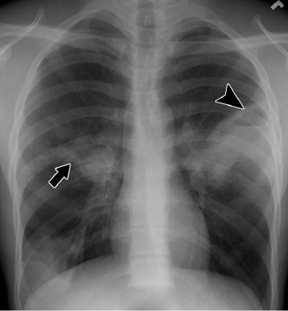
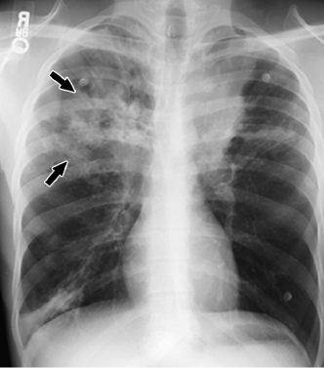
Testing to consider prior to referral
Evaluate TH2 mediated disease
CBC w/ differential
Total IgE
Allergy evaluation?
Long term treatment?
25-OH Vitamin D
Disease modifier
Easy to treat
2000 IU daily
2 view Chest X-Ray
Basic screening of anatomy
Saves time if considering other exams
May help decide next steps

Slide 15
Summary: When to Refer to an Asthma Specialist
Step 4 care or higher
(step 3 for children 0–4 years of age)
Consider referral if patient requires step 3 care (step 2 for children 0–4 years of age)
Not meeting therapeutic goals
After 3–6 months of treatment
Unresponsive to therapy
Life-threatening asthma exacerbation
>2 oral corticosteroids in 1 year
Exacerbation requiring hospitalization
Additional diagnostic testing
Allergy skin testing
PFTs
Laryngorhinoscopy
Bronchoscopy
Other conditions complicate asthma or its diagnosis
Sinusitis, nasal polyps, aspergillosis, severe rhinitis, VCD, GERD, COPD
Considering immunotherapy
Signs and symptoms atypical or problems in differential diagnosis
Additional education and guidance

Slide 16
Asthma CARE Program (Comprehensive Airway and Respiratory Evaluation) Severe Asthma Program (Pulmonary & Sleep Medicine)
Severe Asthma Clinic
Education
Asthma CARE Program
Research
Community
Outreach
Director: Dinesh Pillai, MD
Program Coordinator: Meagan Gatti, NP, AE-C
Clinic Coordinator: Noa Weinstein
Referrals: pulmasthma@childrensnational.org
Funding: Goldwin Foundation, U01 NIH/NIBIB Grant, DOH
Allergist: Will Sheehan, MD
Behavioral Psych: Casey Lawless, PhD
Social Work: Shaina Alvarez, MSW, LGSW
Dedicated RT, RN staff
Nutrition

Slide 17
Definition of Severe Asthma
GINA or NAEPP steps 4–5 treatment x 12 months | High dose ICS + LABA/LTRA /theophylline
Systemic CS for ≥ 50% of the previous year | to prevent ‘‘uncontrolled’’ asthma, or ‘‘uncontrolled‘‘ despite this therapy
Uncontrolled Asthma Definition | 1) Poor symptom control (ACQ consistently >1.5, ACT<20)
 | 2) Frequent severe exacerbations: >2 systemic CS bursts (>3 days each) in past 12 months
 | 3) Serious exacerbations: >1 hospitalization, ICU stay or mechanical ventilation in the previous year
 | 4) Airflow limitation: FEV1 <80% predicted (in the face of reduced FEV1/FVC defined as less than the lower limit of normal)
 | 5) Controlled asthma that worsens on tapering of high doses of ICS or systemic CS (or additional biologics)

Slide 18
Clinical Considerations for Uncontrolled Asthma
CONDITIONS THAT MIMIC ASTHMA | WHAT TO CONSIDER
Dysfunctional breathing/VCD/PVCM | Spiro, ENT, Speech Referral
Recurrent aspiration, dysfunctional swallow | ENT, Speech, GI Referral
GE Reflux | Treat, GI Referral
Anatomical Issue Fixed – central airway, ring, sling, mass Dynamic – Malacia Bronchiectasis | Imaging – CXR, CT, Upper GI Airway visualization
Cystic Fibrosis | Screening (sweat test), genetics
Immune Mediated Airway Dysfunction Hyper-IgE Syndromes Eosinophilic Syndromes Neutrophil mediated disease | Immune work up Immunology Referral Consider Allergy referral
Primary Ciliary Dyskinesia | PCD Research Clinic referral, genetic testing
Interstitial Lung Disease | Imaging (CXR, CT), Lung Biopsy
Prematurity, bronchiolitis | Treat, watch and wait

Slide 19
Moderate Persistent Asthma, Not Controlled OR Severe Persistent Asthma (Medium Dose ICS + LABA/LTRA or higher)
Testing | Abnormal | Consideration
CBC with differential | Eos >0.15 (abs), 4% | Eligible for anti-IL5/IL-4 therapy
 | >10% | Pulmonary eosinophilia risk
IgE | >150 | Eligible for anti-IgE therapy (>30)
 | >1000 | Evaluate for Hyper-IgE, ABPA
CXR | Floating atelectasis | CT scan, serum studies (above)
Spirometry | FEV1, FEV1/FVC<80% | OCS 2 wk challenge, repeat spiro
FeNo | 35 ppb | Serum studies, compliance?
Recurrent Infections
IgA | <10 | Common immunodeficiency
Sweat Test | Elevated | CF
Vaccine Response | Strep Pneumo 7/14 Ab <2.0 | Revaccinate, If low immune issue
PCD Testing | nNO<77; Abnormal VM | PCD likely – send genetics

Slide 20
Lung Function Testing in Pediatric Asthma
Poor perception of bronchial obstruction
<40% of PCP perform PFTs
60% of PCP will never perform PFTs
But will treat asthma
Spirometry recommended in all asthma guidelines
Risk for asthma exacerbation
FEV1<60%_{pred} = 2x increased risk
FEV1 ↑12% response to bronchodilator
Some Pediatricians have in-office spirometry
If not calibrated → 20% day to day variability
Any testing outside of spirometry rarely used
Poorly defined in all asthma guidelines
No good prospective literature evaluating normal values in children

Slide 21
Role of Lung Function Testing
Pre-Post Spirometry
Basic lung function assessment
Oscillometry
Can perform in pre-school aged chldren (>3 years old)
Bronchial Hyperresponsiveness Testing
Exercise specific symptoms
Limitations in exercise
Poor symptom perception
Atypical asthma symptoms
FeNO
Eosinophil mediated airway inflammation
Track response to treatment
Symptom control
Lung function response via spirometry
Compliance
Lung Volumes (pre/post bronchodilator)
Diffusion Capacity
Cardiopulmonary testing

Slide 22
Pulmonary Function Testing
Perform pre/post spiro
Initial visit
Last spiro
Baseline abnormal
Response to bronchodilator
Oscillometry
>3 years old
Unable to do spirometry
Bronchial Hyperresponsiveness
Normal spiro, Symptomatic
Abnormal spirometry,
no bronchodilator response
FeNO
Initial visit
Abnormal last visit
Compliance issues
On OCS
Lung Volumes
Hi dose ICS + Abnormal FVC
Cardiopulmonary Testing
Unclear cardiac vs. pulm etiology
Normal EIB

Slide 23
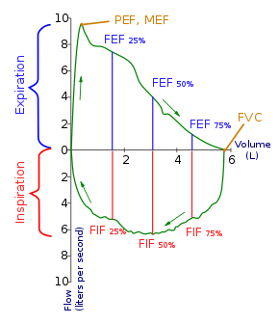
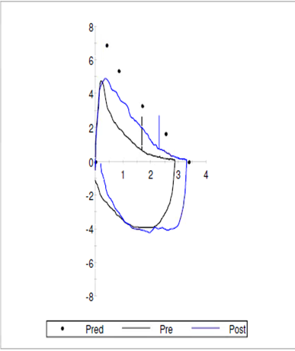
Spirometry
FEV 1
Notes:
(*break down normal PFT in general terms. Emphasize Peak flow, FEV1, and FEF 25-75%. Talk about how each part of expiratory curve represents a different part of the airways)

Slide 24
Pulmonary Function Testing
obstructive lung disease (in children)
PARAMETER | NORMAL/ INTERMITTENT ASTHMA | PERSISTENT ASTHMA |  |  | Significant Response to Bronchodilator
 |  | Mild | Moderate | Severe
FVC (% pred) | >80 | 70-80 | 60-70 | <60 | 12% increase
FEV1 (% Pred) | >80 | >80 (70-80) | 60-80 (60-70) | <60
FEV1/FVC (abs = %) | >85% | >80% <90% | 75-80% | <75%
FEF25-75% (% pred) | >70% | 55-70% | 40-55% | <40% | 25% increase
Advantages
More sensitive to underlying bronchospasm that may not be perceived by the patient
May help identify other pathology to explain symptoms
Responsiveness associated with increased likelihood to respond to inhaled steroids
Limitations
Often normal at baseline in children
May need to induce bronchospasm
May be difficult to perform
National Heart, Lung, and Blood Institute. Expert panel report 3:
guidelines for the diagnosis and management of asthma—full report 2007. www.nhlbi.nih.gov/guidelines/asthma/asthgdln.pdf.

Slide 25
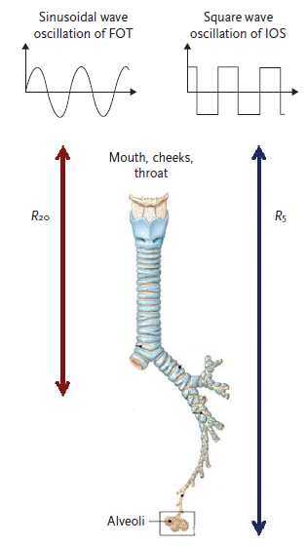
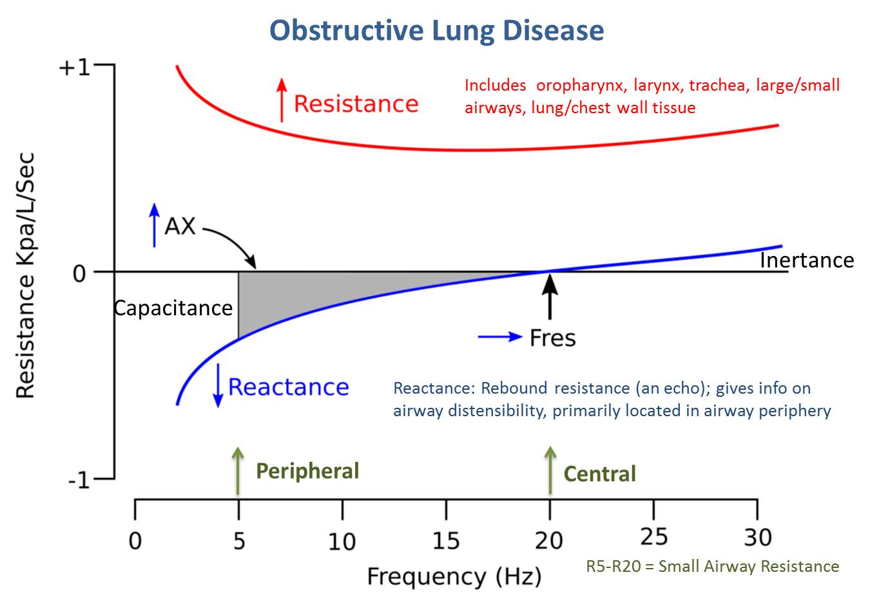
Oscillometry

Slide 26
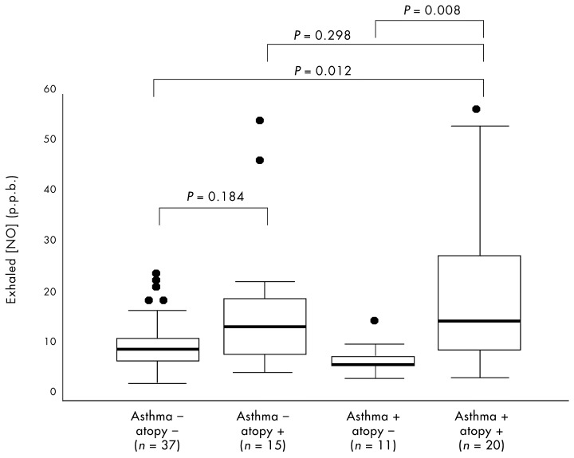
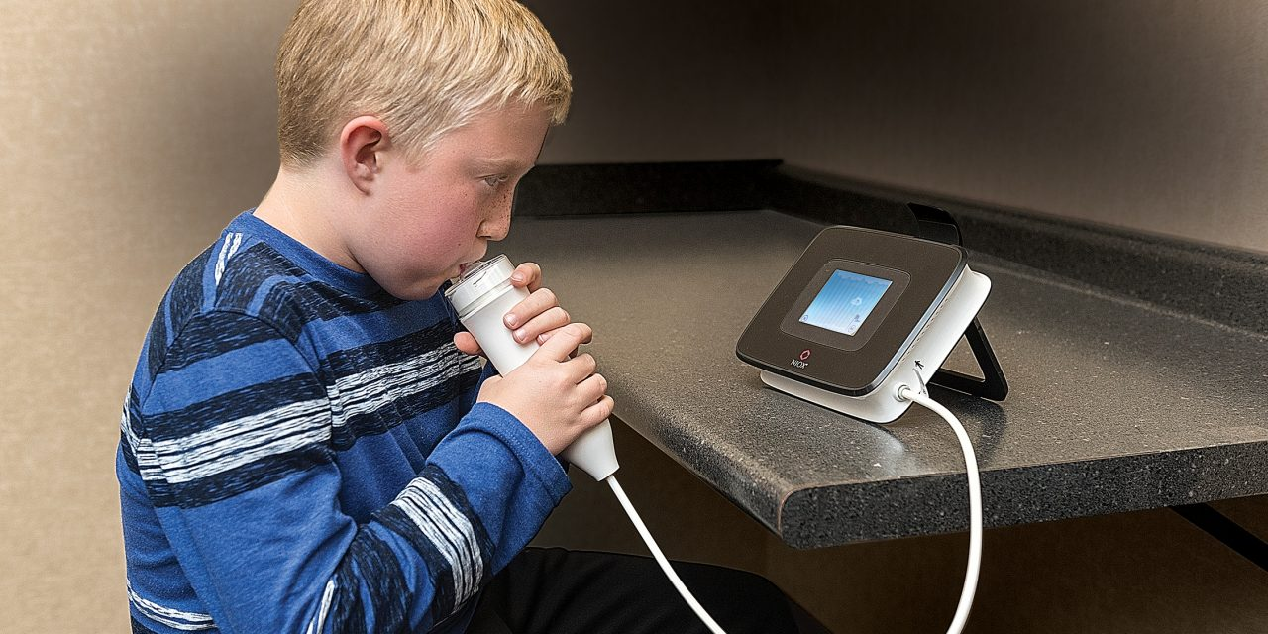
FeNO Fraction of Exhaled nitric oxide
Best studied biomarker in asthma
Reflects airway and tissue eosinophilia
>70% success rate
Can track treatment compliance
Affected by diet, allergen exposure, ETS exposure
May not be reliable in all patients
Clinically Relevant Values
<20 ppb in children with asthma NOT on ICS
Eosinophilic inflammation, ICS responsiveness less likely
20-35 ppb: Intermediate levels
>35 ppb: Eosinophilic Inflammation
>49 ppb: Predictive of asthma relapse
71% sensitivity, 90% specificity
Karhonon, et al. 2002

Slide 27
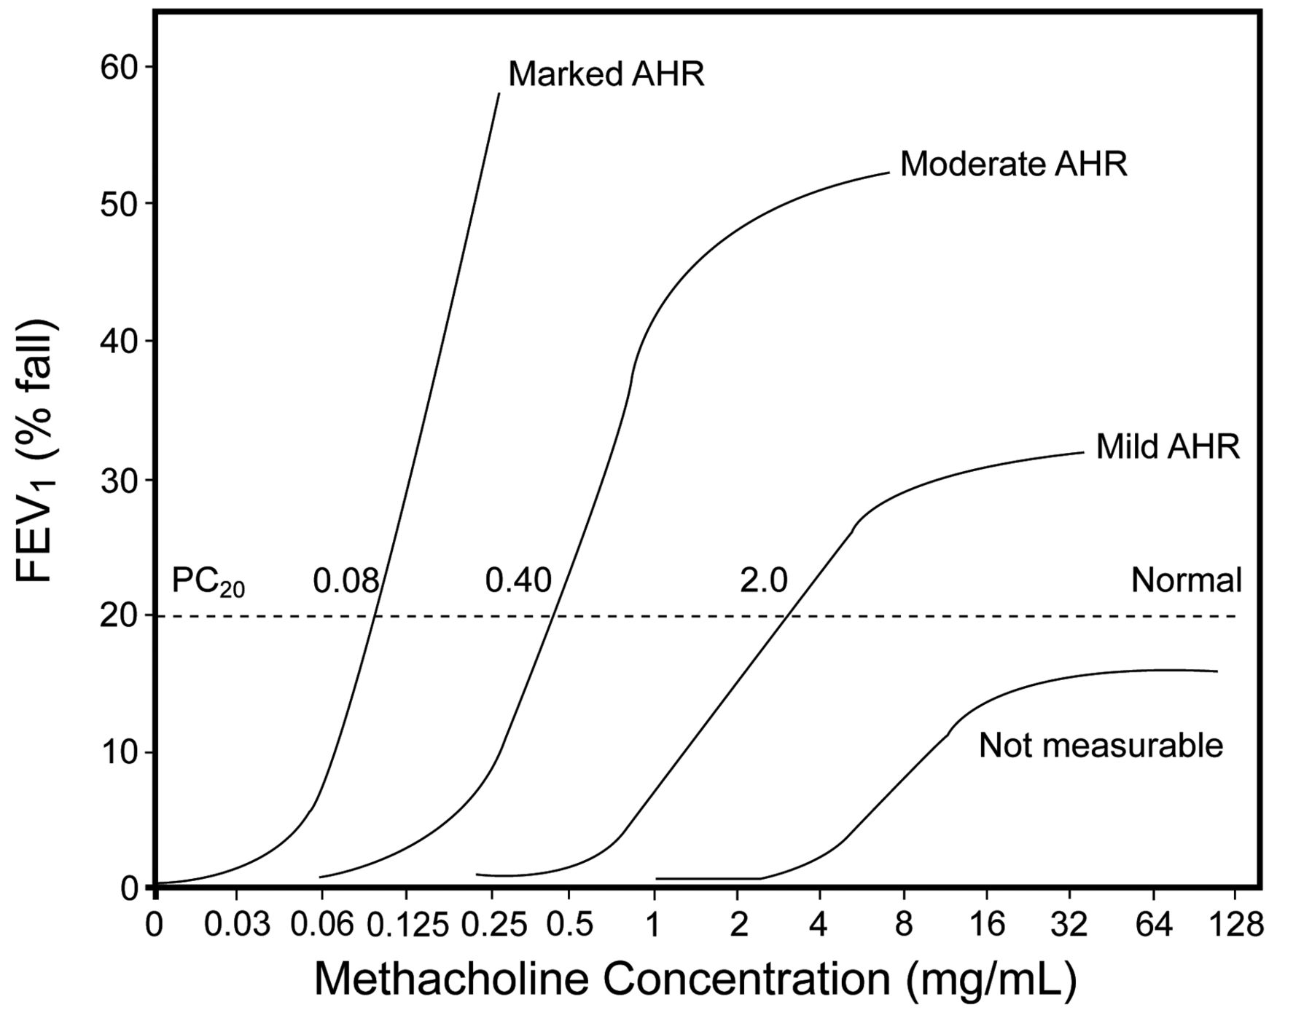
Bronchial Hyperresponsiveness Testing
STUDY | POSITIVE TEST (Reduction in FEV₁)
Exercise Induced Bronchospasm Testing | >10%
Methacholine Challenge | >20%
Mannitol | >15%
Cold Air Provocation | >20%
When to consider:
Exercise specific symptoms
Limitations in exercise
Poor symptom perception
Atypical asthma symptoms
Normal pre/post BD spirometry

Slide 28
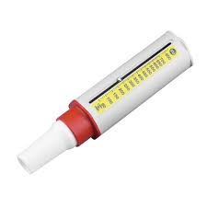
Peak Flow Meter
Advantages
Portable
May be helpful to detect change from established baseline
Limitations
Not sensitive
Extremely dependent on patient effort
Must establish a baseline
Variable based on time of day

Slide 29
Flexible Bronchoscopy with BAL Perform off antibiotics and steroids for at least 4 weeks
Evaluation | Study | Why
Serum (If not done in past 4 weeks) | CBC with diff Compare systemic vs organ specific eosinophilia | WBC, consider infection Peripheral eosinophilia Anti-IL4/5 therapy potential
 | IgE | Anti-IgE therapy potential Evaluate for ABPA
Direct visualization | Airway Anatomy | External compression, FB, RML Syndrome, Aberrant anatomy
 | Airway Dynamics | Malacia, dynamic anatomic changes
BAL Studies | Eosinophilia | >20% suggests significant/acute disease
 | Neutrophilia | >70%, often >90% + elevated WBC
 | Fungal Disease | Culture Pathology
 | Bacterial Culture | PBB, Indolent Infection
 | Alveolar Macrophages | hemosiderin, lipid laden
 | Pepsin Assay | ?GERD/aspiration?

Slide 30
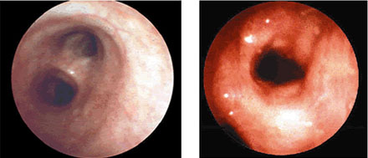
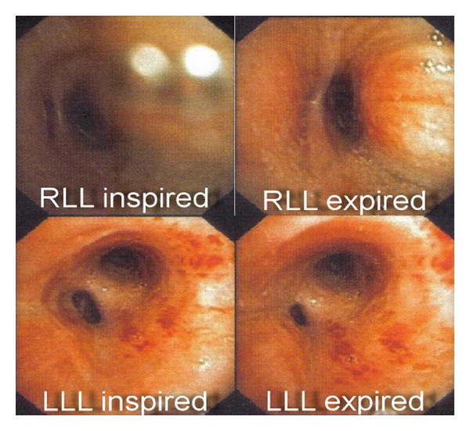
Bronchoscopy in Asthma
Descriptive findings
Erythema
Loss of cartilage rings
Edema
Friability
Evaluate for dynamic airway changes
Rule in/out other issues

Slide 31
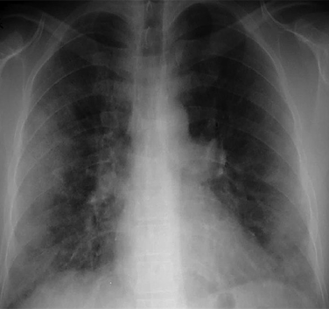
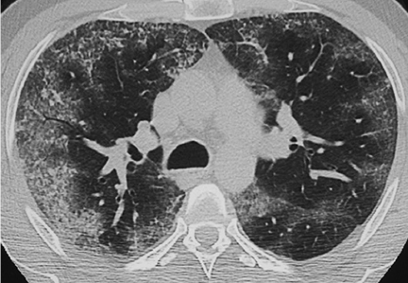
Bronchoscopy/BAL Findings
Pulmonary Eosinophilia
>16% BAL Eos
Treatment
2-4 weeks OCS (tapering over 4 wks)
Refractory dose ICS (>16oo mcg daily)
Inhaled cromolyn 200 mcg 4x/day
Montelukast (leukotriene modifier)
Anti-IL4/5 therapy
EVALUATE other organ systems
GI tract, heart, kidney (biopsy)
Pulmonary Neutrophilia
Protracted Bacterial Bronchitis
Cough x 4wks, +Resp Culture
Treatment
2-4 weeks Augmentin/hi dose Amox
Macrolide therapy x4-16 weeks (Monitor LFTs)
Monitoring
Chest CT
Repeat bronchoscopy
Immunology referral

Slide 32
Biologic Agents Uncontrolled Asthma (Medium Dose ICS + LABA/LTRA or higher)
 | Omalizumab | Mepolizumab | Benralizumab | Dupilumab
Indication | IgE 30-700* IU/mL Age >6 yrs | Serum Eos>150 (Abs) Age >6 yrs | Serum Eos>300 Age >12 yrs | Age >12 yrs
Contraindic-ation | Allergic Reaction to medication
Dose | Varies (Wt, IgE, Age) | 100 mg SQ | 30 mg SQ | 200mg OR 300mg SQ
Frequency | Q2 OR q4 weeks | Monthly | Monthly x3 Q2 months | 400/600mg x1 200/300mg q2wk
Target | IgE binding | IL-5 antagonist | IL-5Rα antagonist | IL-4Rα antagonist
Consider early, at moderate persistent asthma (medium dose ICS)

Slide 33
Summary
General Practitioners
Be comfortable initiating treatment for moderate persistent asthma
Medium ICS +/- LABA
Add Montelukast
Treat common co-morbidities
Re-evaluate every 3 months
Consider basic evaluations at time of referral
Can help fast track choosing higher level treatment

Slide 34
Summary
Pulmonary Diagnostic Evaluation In Asthma
Lung Function Testing
Underutilized
Only objective measure included in asthma guidelines
Can track longitudinally
Provocation Testing: hyper-reactivity important in defining asthma
FeNO: May be useful to track response to therapy
Oscillometry: Provides sensitive data on airway dynamics
Bronchoscopy
Poorly defined normal values
Valuable insight beyond imaging
Cannot replace direct evaluation of anatomy in symptomatic patient
Direct visualization of airway dynamics provides vital information
Helpful in long term evaluation in chronic conditions

Slide 35
Thank you
Severe Asthma Program pulmasthma@childrensnational.org
Aerodigestive Program aerodigestive@childrensnational.org
dpillai@childrensnational.org

Slide 36
High Dose ICS Threshold (µg)
Corticosteroid | 6 - 12 Years Old |  | > 12 Years Old
 | ERS/ATS | GINA | ERS/ATS | GINA
Beclomethasone Dipropionate QVAR | ≥800 (DPI/CFC MDI); ≥320 (HFA MDI) | >400 (DPI/CFC MDI); >200 (HFA MDI) | ≥2000 (DPI/CFC MDI); ≥1000 (HFA MDI) | >1000 (CFC MDI); >400 (HFA MDI)
Budesonide PULMICORT, SYMBICORT | ≥800 (MDI/DPI) | >400 (MDI/DPI) | ≥1600 (MDI/DPI) | >800 (DPI)
Ciclesonide ALVESCO | ≥160 (HFA MDI) | >160 (HFA MDI) | ≥320 (HFA MDI) | >320 (HFA MDI)
Fluticasone Propionate FLOVENT, ADVAIR | ≥500 (HFA MDI/DPI) | >500 (HFA MDI); >400 (DPI) | ≥1000 (HFA MDI/DPI) | >500 (HFA MDI/DPI)
Mometasone Furoate ASMANEX, DULERA | ≥500 (DPI) | ≥440 | ≥800 (DPI) | >440
Triamcinolone Acetonide ASMACORT | ≥1200 | >1200 | ≥2000 | >2000

Slide 37
Inpatient
IMPACT DC
Community Pediatricians
Functional Studies
PFTs
FeNO
+/- CXR, PSG
Pulmonary/ Severe Asthma Clinic
Screening Labs
(no OCS x 4 weeks)
CBC w/ Man. Diff.
IgE, +/- IgA
Vitamin D
Aerodigestive Clinic
Allergy/
Immunology
Ciliary Dysfunction Clinic
EoE Clinic
Laryngoscopy
EGD
DLB
Bronchoscopy
Ciliary Biopsy
FESS/FEES
SPT
RAST
AIT
Immune W/U
nNO
Video
Microscopy
Genetics
Sleep Clinic
Food Allergies
EoE Treatment
PSG/Treatment
Notes:
SAC Schematic with subspecialty work up/plan – improve clinical endotyping and develop opportunities for research (i.e. improve understanding of co-morbidities in severe asthma)

